Slide 1
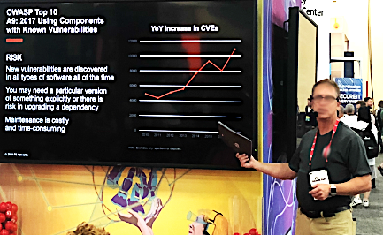
Tool-toTool (3T) Software Bill of Materials (SBOM) Specification
© 2020 The MITRE Corporation. All rights reserved. Approved for Public Release; Distribution Unlimited. Case No: 20-01465-22

Slide 2

















Enabling Adoption of SBOMs
SBOMs
Water
Public Health
Telecommunications
Banking and Finance
Key Assets
Agriculture and Food
Energy
Transportation
Chemical Industry
Postal and Shipping
SBOMs
SBOMs
Sectors
SBOMs
End Users in Industry, Government, and Commerce
Medical Devices
Merchandise
Automobiles
Trains
Vessels/Boats
Building Mngt Sys
Software
Assets/
Capabilities
Product & Service Suppliers
Integrated Development Environments (IDEs)
Software Composition Analysis
Tool-to-Tool SBOM Standard effort (3T-SBOM)
Source Code & Package Repositories
Frameworks
Cloud Tools
Build Choreography
Lic Mngt
Software
Ecosystems
Tools & Capabilities for Software

Slide 3
Ecosystem of SW Development, Integration, and Management Tools
Vulnerability Information
Licensing Information
Package Repos
(Public & Private)
Test
Source Code Repos
(Public & Private)
Operations
Build choreography
Software Composition Analysis Capabilities
Developer “Desktops”

Slide 4
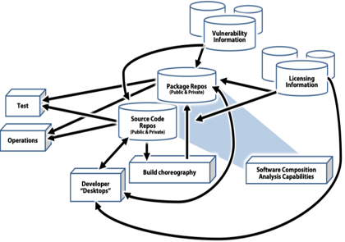
SW Development, Integration, and Management Tools
Source Code & Package Repositories
Amazon ECR, Assembla, Azure Container Registry, Beanstalk, Bitbucket, Codebase, Docker, GitHub, GitLab, Glitch, Google Container Registry, JFrog Artifactory, JFrog Xray, inedo, Kubernetes, Launchpad, Maven, Nexus (Sonatype), Phabricator, ProjectLocker, Repository Hosting, Savannah, SourceForge, SourceRepo, Subversion, and Unfuddle
Build & Build Choreography Capabilities
Ansible, Autorabit, Bamboo, Bitrise, Buildkite, Buildroot, CircleCI, CMake, CruiseControl, Final builder, GCC, Gitlab CI, GoCD, Integrity, Jenkins, Strider CD, TeamCity, Terraform, Travis CI, Urbancode, and Vagrant
Developer Desktops (Embedded, Web, Cloud, Desktops/Servers)
IDEs: Android Studio, AppCode, Atom, BlueJ, CLion, Cloud9 IDE, Code Blocks, CodeCharge Studio, CodeLobster, CodePen, DataGrip, Eclipse, GoLand, IDLE, IntelliJ IDEA, LINX, Microsoft Visual Studio, MPLAB, NetBeans, PhpStorm, Pycharm, Rider, RubyMine, Spiralogics Application Architecture, WebStorm, Xcode, and Zend Studio
Frameworks: .NET, Angular, Ansible, Apache Spark, ASP.NET, Bootstrap, Chef, Cordova, CryEngine, Django, Drupal, Express, Flask, Flutter, Hadoop, HTML5 Builder, Laravel, Node.js, Pandas, Puppet, React Native, React.js, Ruby on Rails, Spring, TensorFlow, Torch/PyTorch, Unity D, Unreal Engine, Visual Online, Vue.js, and Xamarin
Cloud Tools: Azure, AWS CodeBuild, Cloud Foundry, Google Cloud Build, Kwatee, Pivotal, and Red Hat
Software Composition Analysis:
Black Duck Software Composition Analysis (Synopsys), CAST Highlight (CAST Software), Finate State, FlexNet Code Insite (Flexera), Ion Channel, Insignary, GrammaTech, SourceClear, Sonatype, Snyk, and WhiteSource

Slide 5
Usage Scenarios for Tool-to-Tool SBoM
Refer, Transfer or Purchase
(definition of what it is)
Proper and Legal
(conditions about its use)
Pedigree
(history of how it was produced)
Known Sw Vulns
(known fixes are applied to it)
Provenance
(chain of custody of it)
Assurance
(safe-secure-resilient)
Integrity
(cryptographic basis of unalteredness)
SBoM of a SW Service
(SBoM of sw delivering service)
Supply Chain Sequence Integrity
Between Tiers
Spanning Tiers
SBoM
Supplier
Customer
Contract/Agreement

Slide 6
Launched 24 Sep 2019

Slide 8


Lowering Adoption Hurdles for SBOMs and more
SBOMs
Water
Public Health
Telecommunications
Banking and Finance
Key Assets
Agriculture and Food
Energy
Transportation
Chemical Industry
Postal and Shipping
SBOMs
SBOMs
Sectors
End Users in Industry, Government, and Commerce
SBOMs
Medical Devices
Merchandise
Automobiles
Trains
Vessels/Boats
Building Mngt Sys
Software
Assets/
Capabilities
Product & Service Suppliers
Integrated Development Environments (IDEs)
Software Composition Analysis
Inventory Management Systems
Product Lifecycle Management (PLM) Tools
Source Code & Package Repositories
Frameworks
Cloud Tools
Standard Operating Procedures
CAD Systems
Catalog Builders
Build Choreography
Lic Mngt
Software
Ecosystems
BOM Management Systems
Hardware
Ecosystems
Tools & Capabilities for Software
Tools & Capabilities for Hardware
License Profile
Pedigree Profile
Provenance Profile
SW BOM Profile
HW BOM Profile
X Profile
Y Profile
Z Profile
Core BOM
SPDX 3.0 efforts
© 2020 The MITRE Corporation. All rights reserved. Approved for Public Release; Distribution Unlimited. Case No: 20-01465-22

